Slide 1
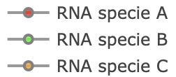
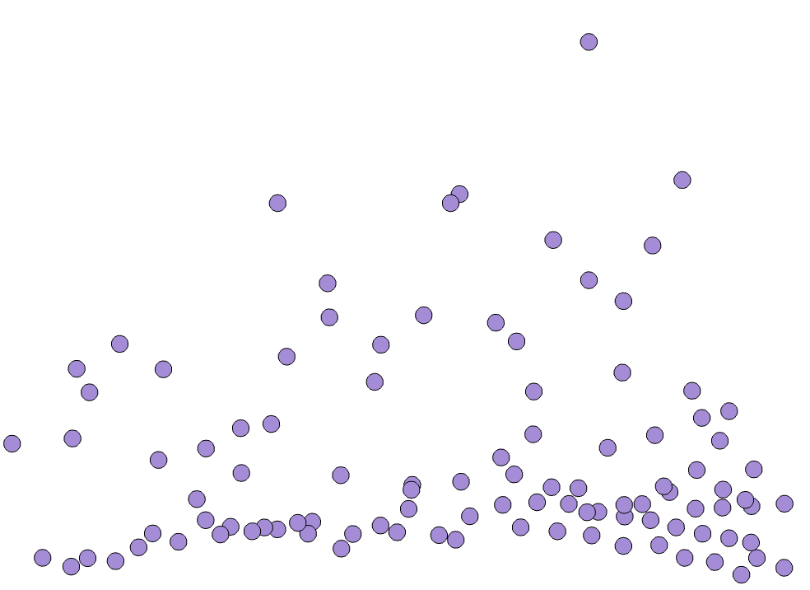
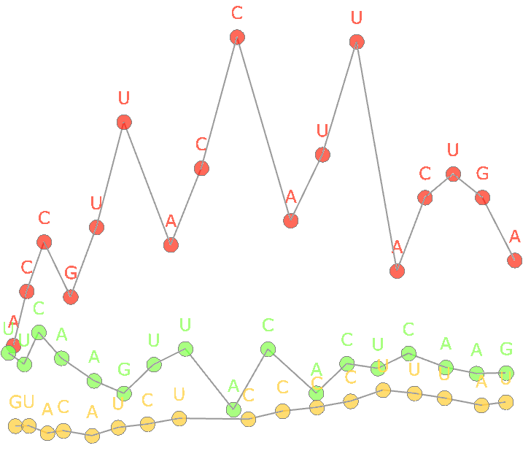
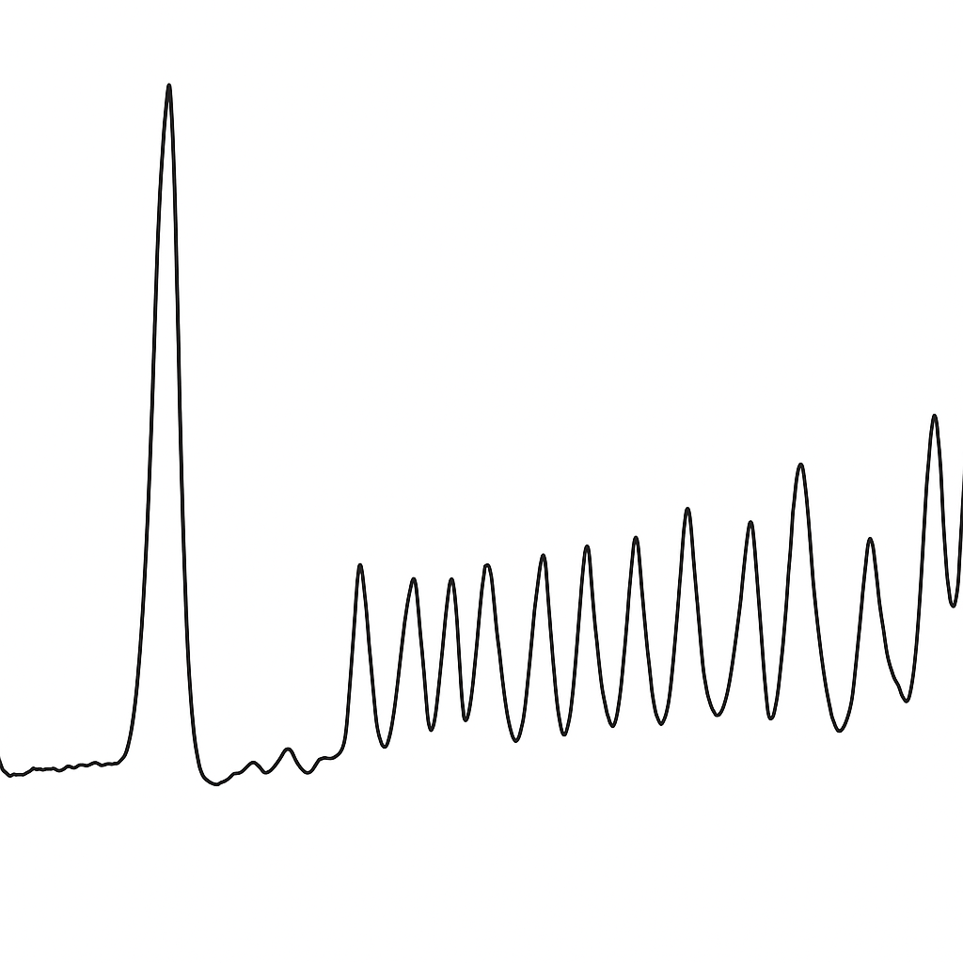
Input
SI
Output
SI
LC-MS
Advantages:
-100% De-novo sequencing accuracy under mixture setting
-Using sum intensity as a separation tool for layer-by-layer sequence extraction reduces false positives during base calling
-Can sequence impurities among desired RNA mixtures
t_{R}
Mass
m/z
t_{R}
Mass
hydrolyzed RNA fragment LC-MS data

Slide 2
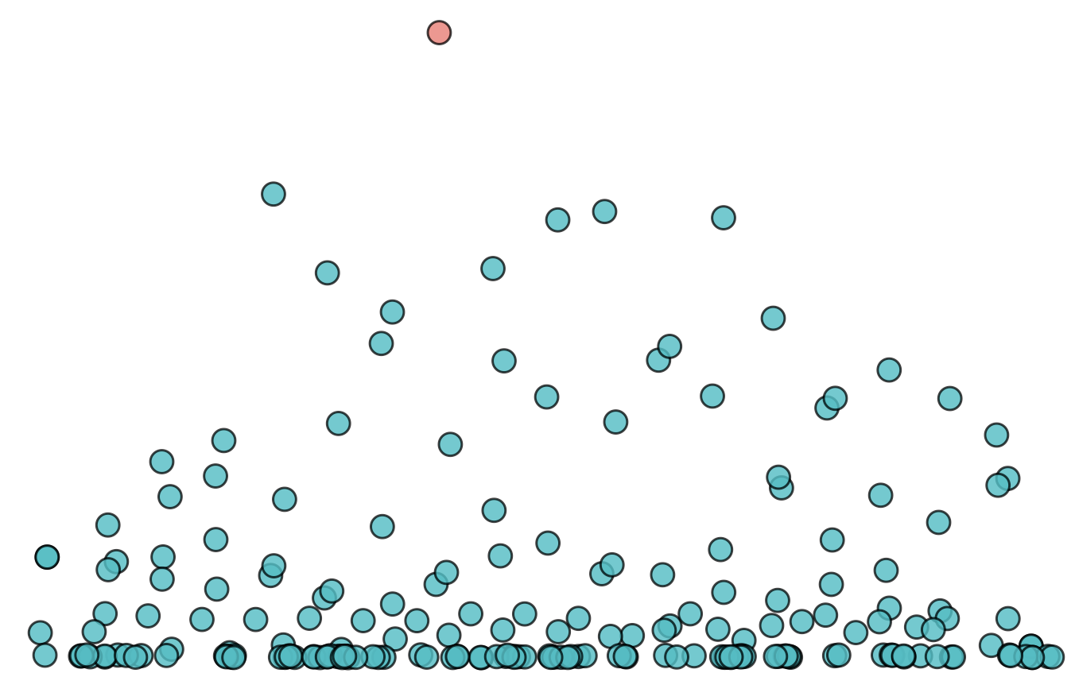
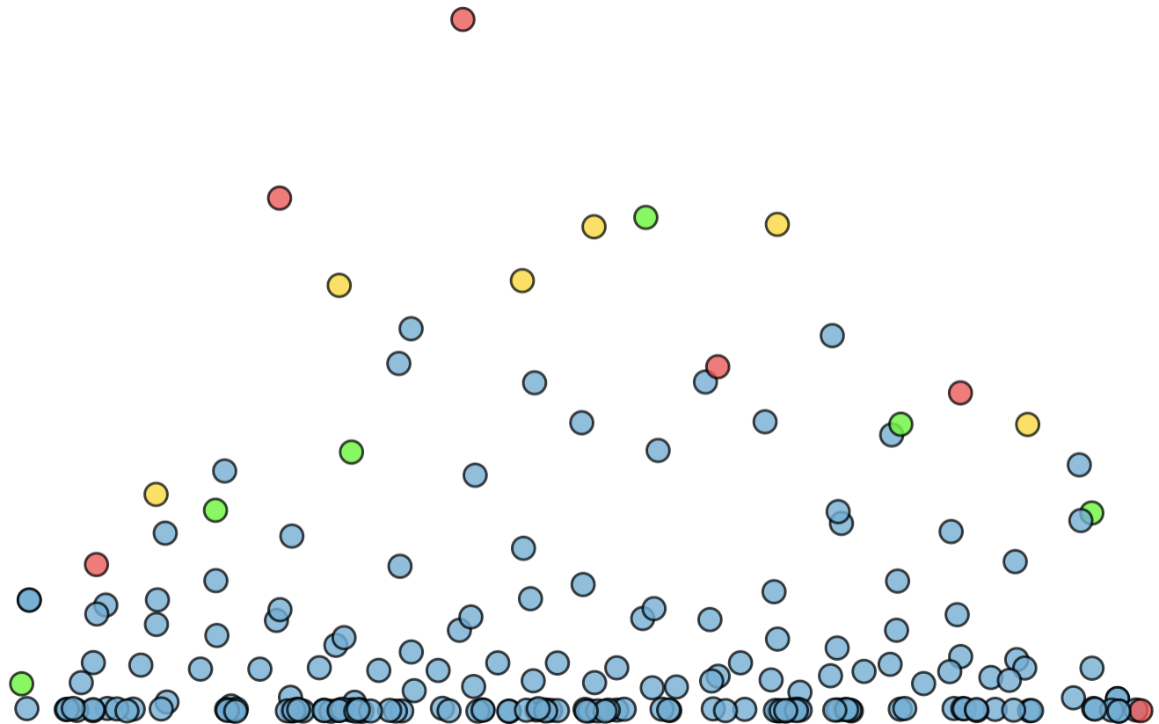
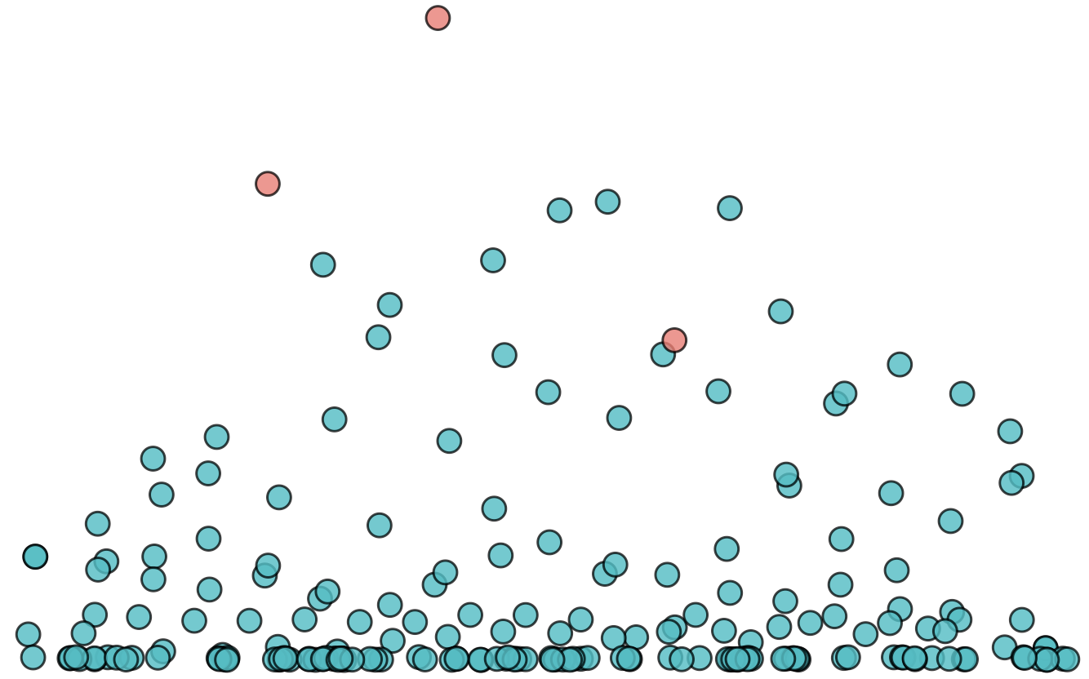
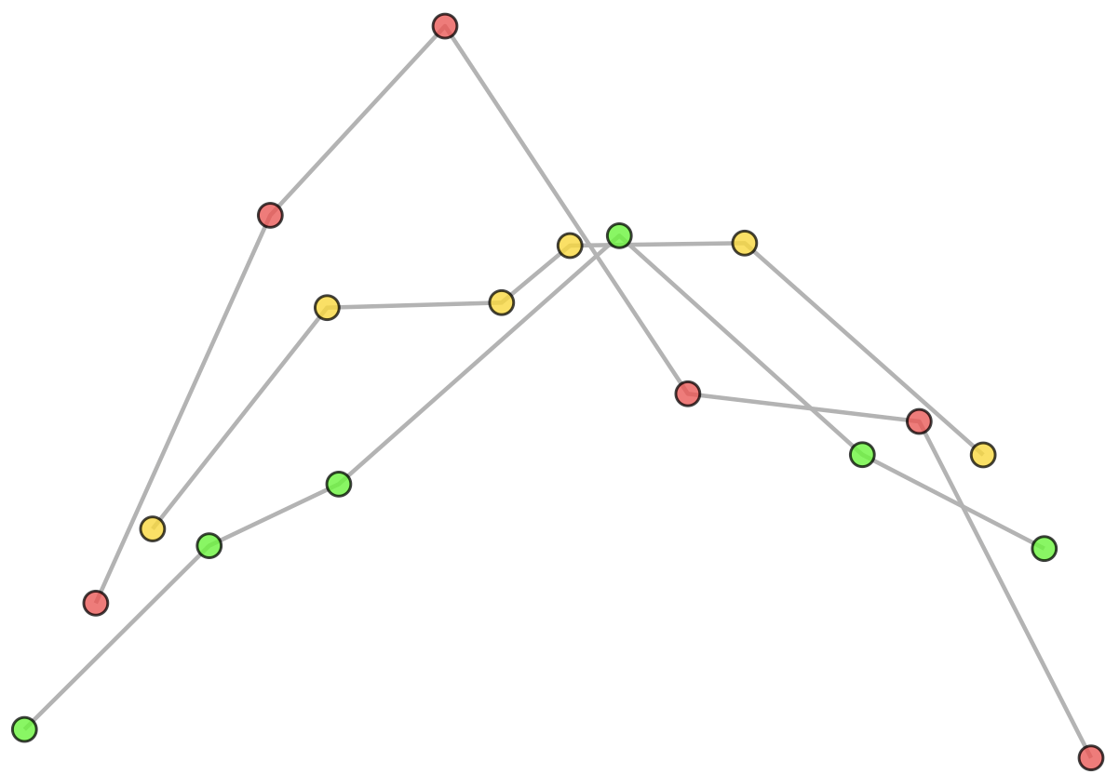
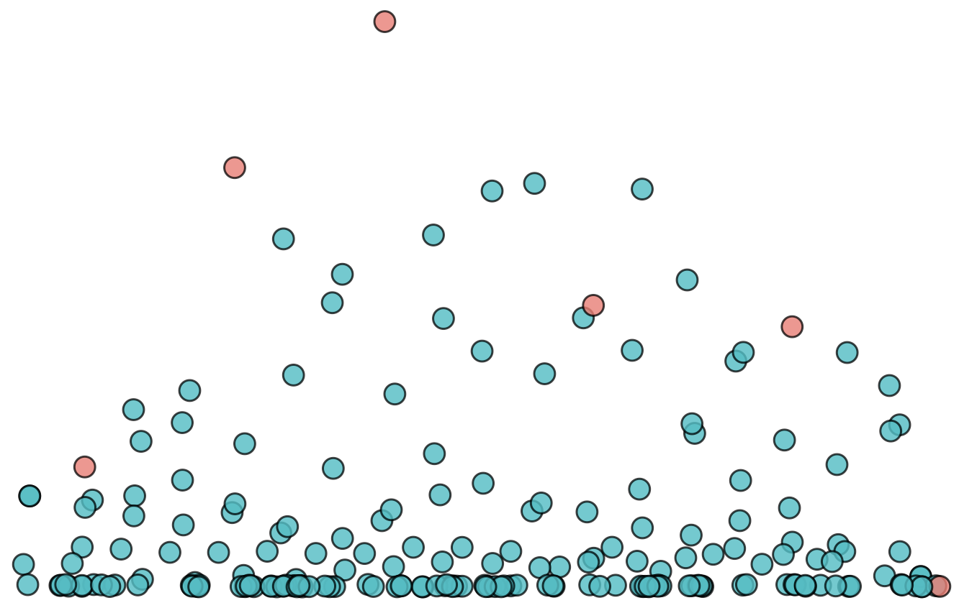
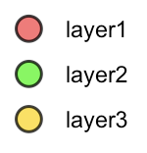
Nested Algorithm
Base Calling
RNA Ladders Formation
Ladder Assembly
1. Select the data point with highest intensity
SI
4. Repeat step 1-3 on the remaining dataset
6. Different layers combined increases coverage
SI
A
C
G
G
U
A
C
G
G
U
U
G
G
C
A
Native:
G
U
C
A
C
Overlap confirms identity
Mass
2. Search for mass corresponds to next base match
Sodium Adducted:
G
U
C
A
C
SI
C
G
Mass
Mass
5. Collect ladders formed in a “layer by layer” fashion
7. 3’ and 5’ ladders cross-verifies each other
3. Repeat step 2 until no further match can be found
SI
C
A
C
G
G
U
A
C
G
G
U
G
3’ Ladder:
SI
U
C
A
Cross-verification
increases
level of confidence
A
C
C
G
G
G
G
A
5’ Ladder:
U
U
U
G
G
C
A
Mass
Mass

Slide 3
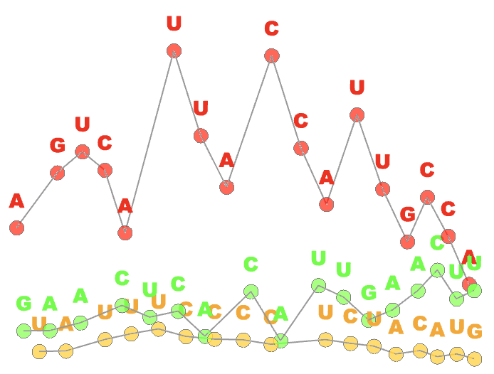
Input
Intensity
Output
Intensity
LC-MS
Advantages:
-100% De-novo sequencing accuracy under mixture setting
-Using sum intensity as a separation tool for layer-by-layer sequence extraction reduces false positives during base calling
-Can sequence impurities among desired RNA mixtures
t_{R}
Mass
m/z
t_{R}
Mass
hydrolyzed RNA fragment LC-MS data

Slide 4
Nested Algorithm
Base Calling
RNA Ladders Formation
Ladder Assembly
1. Select the data point with highest intensity
Intensity
4. Repeat step 1-3 on the remaining dataset
6. Different layers combined increases coverage
Intensity
A
C
G
G
U
A
C
G
G
U
U
G
G
C
A
Native:
G
U
C
A
C
Overlap confirms identity
Mass
2. Search for mass corresponds to next base match
Sodium Adducted:
G
U
C
A
C
Intensity
C
G
Mass
Mass
5. Collect ladders formed in a “layer by layer” fashion
7. 3’ and 5’ ladders cross-verifies each other
3. Repeat step 2 until no further match can be found
Intensity
C
A
C
G
G
U
A
C
G
G
U
G
3’ Ladder:
Intensity
U
C
A
Cross-verification
increases
level of confidence
A
C
C
G
G
G
G
A
5’ Ladder:
U
U
U
G
G
C
A
Mass
Mass

Slide 5
: Sequence covered by 5’ only
Base Calling
: Sequence covered by both 3’ and 5’
SI
: Sequence covered by 3’ only
Mass

Slide 6
Figure 1 new version 0227

Slide 7
Steps
1. find three real RNAs, plot them in 2D plots.
2. Draw an intact sample plot accordingly
3. build a bar plot for the most abundant RNA sequence
4. ladder assembly in PPT.
5. Draw an intact sample with only low intensity RNAs remaining.
6. Produce sequence output.

Slide 8
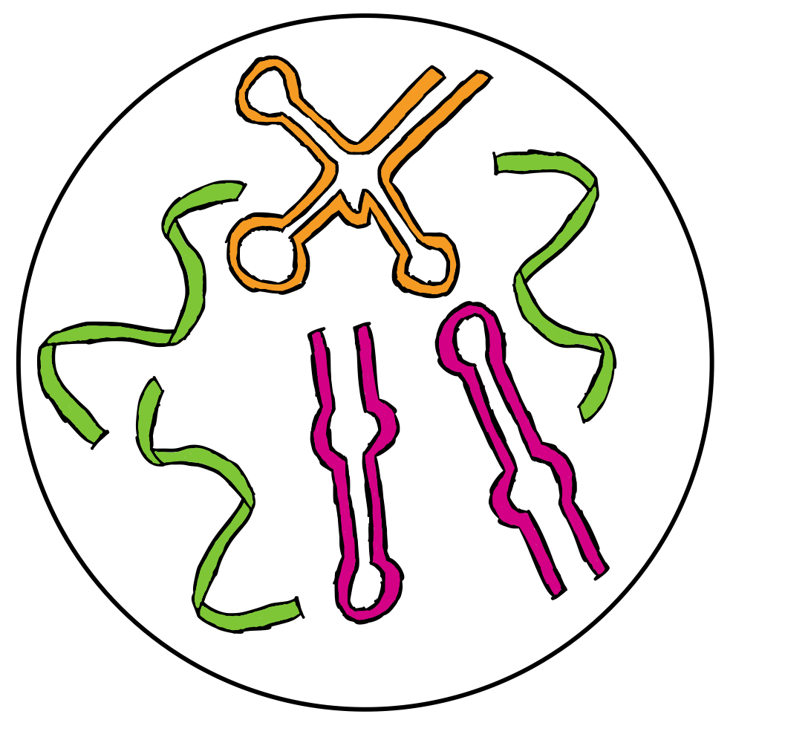
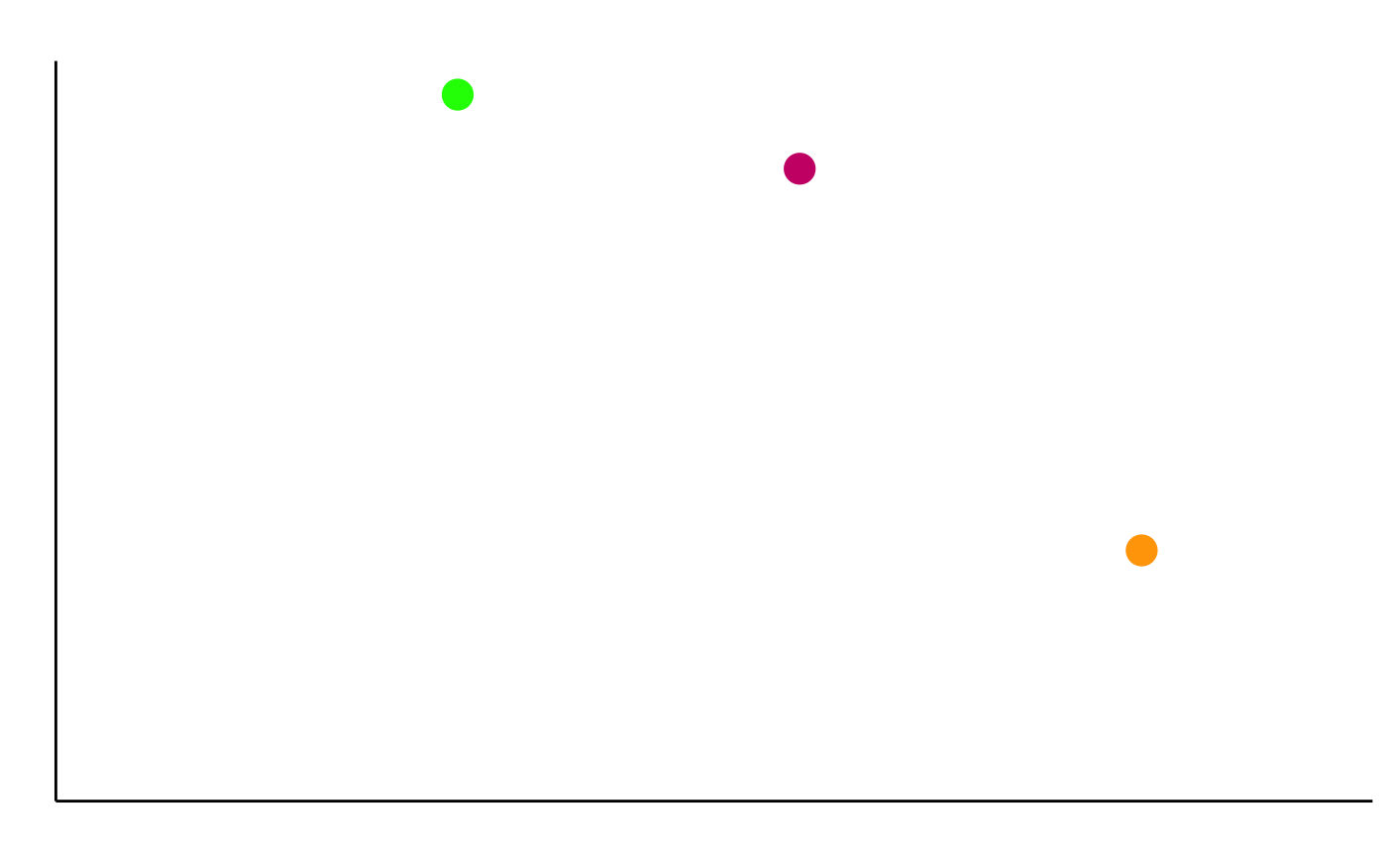
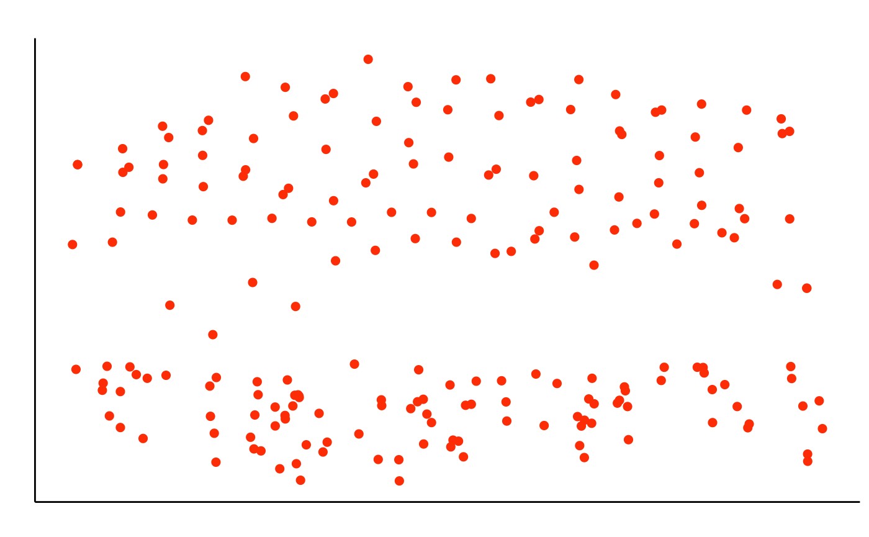
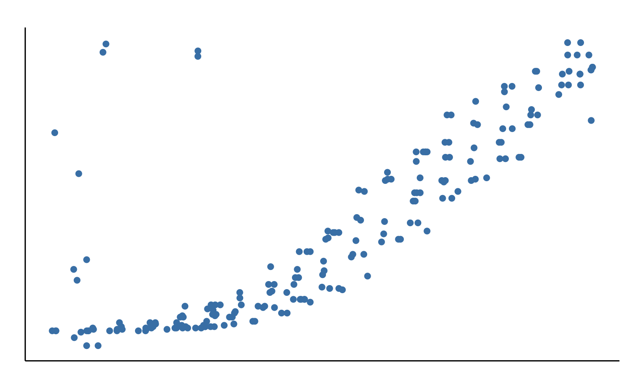
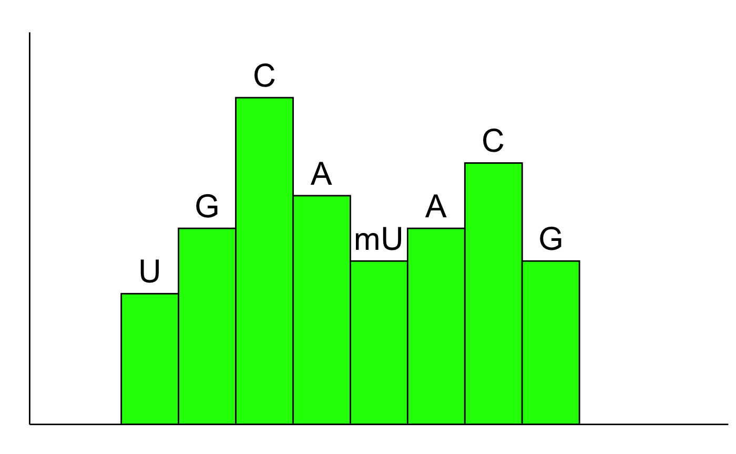
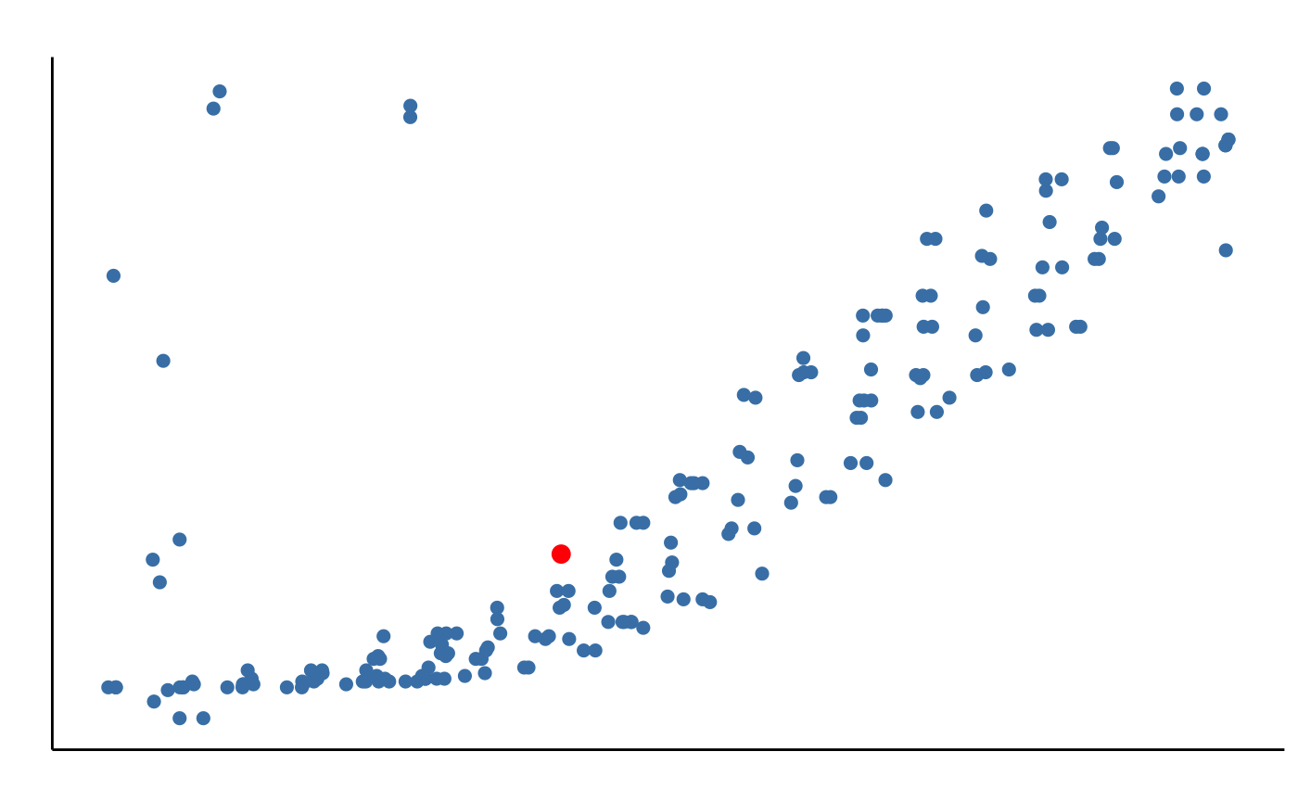
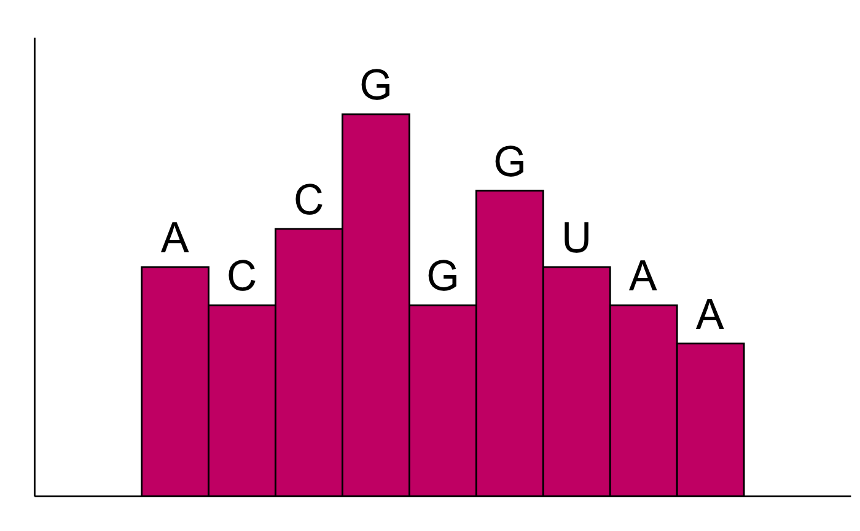
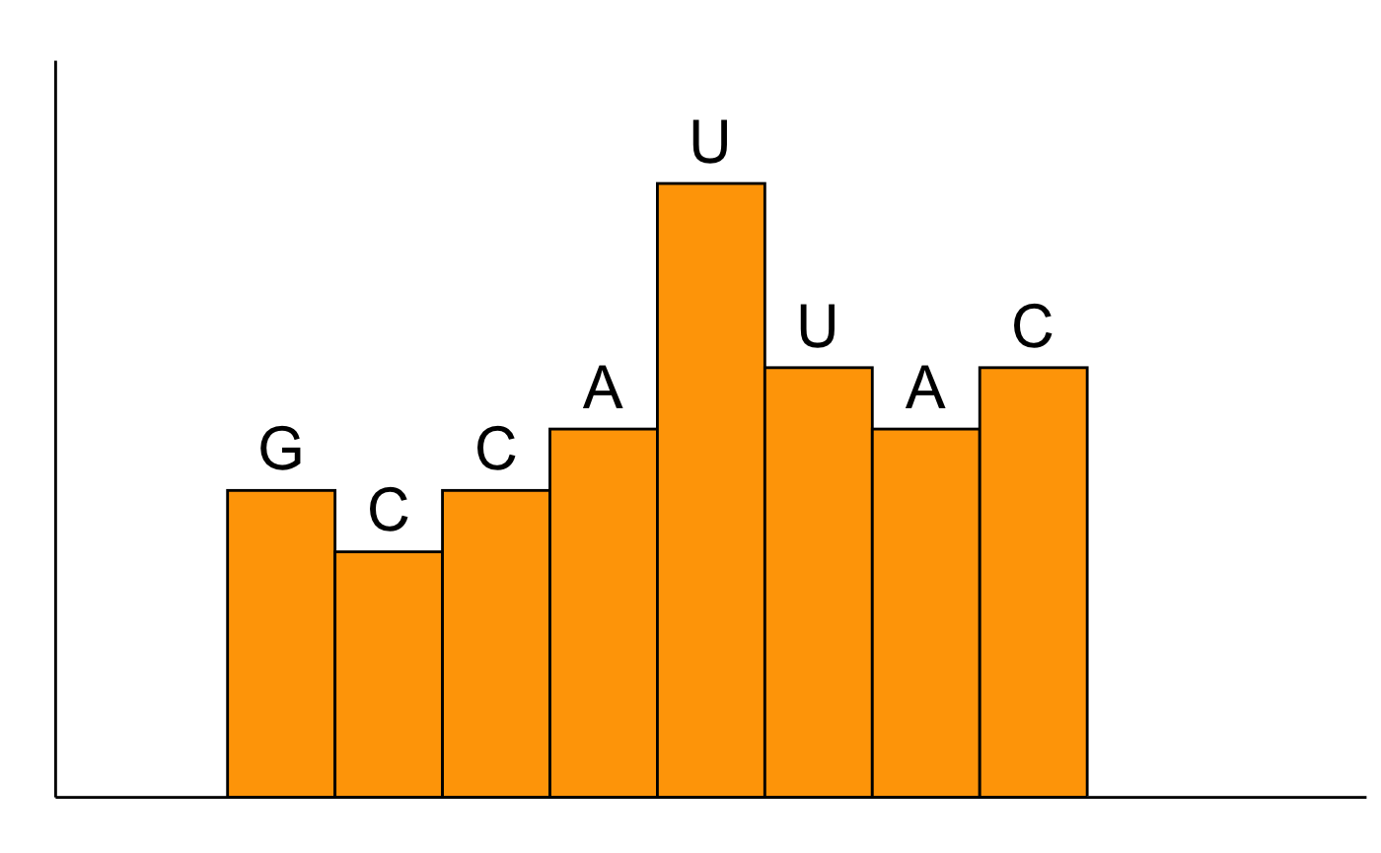
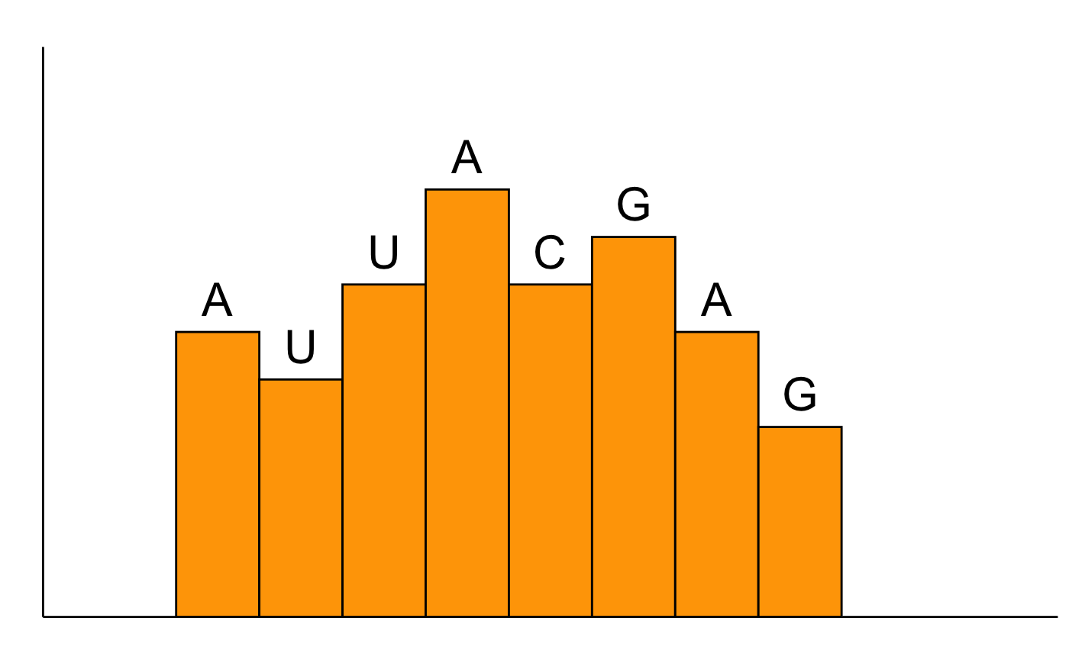
SI
① No acid hydrolysis treatment
Determine number of RNAs and their sum intensity in the sample respectively
LC-MS
Mass
SI
t_{R}
② Controlled acid hydrolysis
+
LC-MS
mixture of RNAs with different abundances
Mass
Mass
Ladder #1
③ Start base calling from the mass point with highest sum intensity in the dataset
SI
t_{R}
G
④ Generate RNA ladder
C
A
mU
Ladder position
C
A
SI
Ladder #2
G
U
Repeat steps ③&④ to generate more ladders
: mass point with highest sum intensity in the dataset
Mass
Ladder position
SI
Ladder #3
Ladder #1:
U
G
C
A
mU
A
C
G
5’ 3’
⑥ Final Sequence Output
Most abundant RNA sequence: UGCA(mU)ACG
2nd most abundant RNA sequence: ACCGGGUAA
3rd most abundant RNA sequence: GCCAUUACGAG
......
Ladder #2:
A
C
C
G
G
G
U
A
A
⑤ Assemble ladders
5’ 3’
Ladder position
Ladder #3:
G
C
C
A
U
U
A
C
Ladder #4
5’ 3’
SI
Ladder #4:
A
U
U
A
C
G
A
G
5’ 3’
Ladder position

Slide 9
SI
① No acid hydrolysis treatment
Determine number of RNAs and their sum intensity in the sample respectively
LC-MS
Mass
SI
t_{R}
② Controlled acid hydrolysis
+
LC-MS
mixture of RNAs with different abundances
Mass
Mass
Ladder #1
③ Start base calling from the mass point with highest sum intensity in the dataset
SI
t_{R}
G
④ Generate RNA ladder
C
A
mU
Ladder position
C
A
SI
Ladder #2
G
U
Repeat steps ③&④ to generate more ladders
: mass point with highest sum intensity in the dataset
Mass
Ladder position
SI
Ladder #3
Ladder #1:
U
G
C
A
mU
A
C
G
5’ 3’
⑥ Final Sequence Output
Most abundant RNA sequence: UGCA(mU)ACG
2nd most abundant RNA sequence: ACCGGGUAA
3rd most abundant RNA sequence: GCCAUUACGAG
......
Ladder #2:
A
C
C
G
G
G
U
A
A
⑤ Assemble ladders
5’ 3’
Ladder position
Ladder #3:
G
C
C
A
U
U
A
C
Ladder #4
5’ 3’
SI
Ladder #4:
A
U
U
A
C
G
A
G
5’ 3’
Ladder position

